Slide 1
Chapter 3
Problem-solving Agents

Slide 2
1.9 Problem-Solving Agents
According to psychology, “a problem-solving refers to a state where we wish to reach to a definite goal from a present state or condition.”
According to computer science, a problem-solving is a part of artificial intelligence which encompasses a number of techniques such as algorithms, heuristics to solve a problem.
Problem-solving agent in AI is goal-based agents that focus on goals, which uses a group of algorithms, and techniques to solve a well-defined problem.
And these agents are different from reflex agents who just have to map states into actions and can’t map when storing and learning both are bigger.
The Problem Solving Agents decide what to do by finding a sequence of actions that leads to a desirable state or solution.
The different stages that Problem-solving agents perform, to arrive at a desired state or solution are:
Articulating or expressing the desired goal and the problem is tried upon, clearly.
Explore and examine
Find the solution from the various algorithms on the table.
The final step is Execution!
The problem-solving agent performs precisely by defining problems and several solutions.

Slide 3
Steps performed by Problem-solving agent
Goal Formulation: It is the first and simplest step in problem-solving. It organizes the steps/sequence required to formulate one goal out of multiple goals as well as actions to achieve that goal. Goal formulation is based on the current situation and the agent’s performance measure.
Problem Formulation: It is the most important step of problem-solving which decides what actions should be taken to achieve the formulated goal.
There are following five components involved in problem formulation:
Initial State: It is the starting state or initial step of the agent towards its goal.
Actions: It is the description of the possible actions available to the agent.
Transition Model: It describes what each action does.
Goal Test: It determines if the given state is a goal state.
Path cost: It assigns a numeric cost to each path that follows the goal.
The problem-solving agent selects a cost function, which reflects its performance measure. An optimal solution has the lowest path cost among all the solutions.

Slide 4
Initial state, actions, and transition model together define the state-space of the problem.
State-space of a problem is a set of all states which can be reached from the initial state followed by any sequence of actions.
The state-space forms a directed map or graph where nodes are the states, links between the nodes are actions, and the path is a sequence of states connected by the sequence of actions.
Search: It identifies all the best possible sequence of actions to reach the goal state from the current state. It takes a problem as an input and returns solution as its output.
Solution: It finds the best algorithm out of various algorithms, which may be proven as the best optimal solution.
Execution: It executes the best optimal solution from the searching algorithms to reach the goal state from the current state.

Slide 5
Well-defined problems and solutions
Simple problem solving agent, it first formulates a goal and a problem, searches for a sequence of actions that would solve the problem, and then executes the actions one at a time. When this is complete, it formulates another goal and starts over.
function SIMPLE-PROBLEM-SOLVING-AGENT(percept) returns an action
persistent: seq, an action sequence, initially empty
state, some description of the current world state
goal, a goal, initially null
problem, a problem formulation
state ← UPDATE-STATE(state, percept)
if seq is empty then
goal ← FORMULATE-GOAL(state)
Problem ← FORMULATE-PROBLEM(state, goal)
seq ← SEARCH(problem)
if seq = failure then return a null action
action ← FIRST(seq)
seq ← REST(seq)
return action

Slide 6
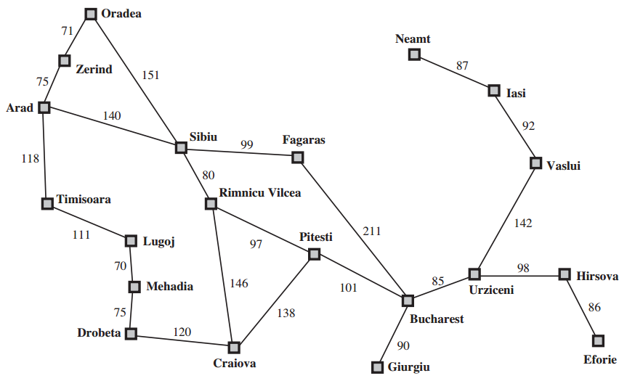
A simplified road map of part of Romania

Slide 7
INITIAL STATE The initial state that the agent starts in. For example, the initial state for our agent in Romania might be described as In(Arad).
ACTIONS A description of the possible actions available to the agent. Given a particular state s, ACTIONS(s) returns the set of actions that can be executed in s. We say that each of APPLICABLE these actions is applicable in s.
For example, from the state In(Arad), the applicable actions are {Go(Sibiu), Go(Timisoara), Go(Zerind)}.
TRANSITION MODEL A description of what each action does; the formal name for this is the transition model, specified by a function RESULT(s, a) that returns the state that results from doing action a in state s. We also use the term successor to refer to any state reachable from a given state by a single action.
For example, we have RESULT(In(Arad),Go(Zerind)) = In(Zerind) .

Slide 8
GOAL TEST The goal test, which determines whether a given state is a goal state. Sometimes there is an explicit set of possible goal states, and the test simply checks whether the given state is one of them. The agent’s goal in Romania is the singleton set {In(Bucharest)}.
Sometimes the goal is specified by an abstract property rather than an explicitly enumerated set of states. For example, in chess, the goal is to reach a state called “checkmate,” where the opponent’s king is under attack and can’t escape.
PATH COST A path cost function that assigns a numeric cost to each path. The problem-solving agent chooses a cost function that reflects its own performance measure. For the agent trying to get to Bucharest, so the cost of a path might be its length in kilometers.

Slide 9
1.10 Example Problems
The problem-solving approach has been applied to a vast array of task environments.
Toy problems The first example we examine is the vacuum world This can be formulated as a problem as follows:
States: The state is determined by both the agent location and the dirt locations. The agent is in one of two locations, each of which might or might not contain dirt. Thus, there are 2 × 2(2) = 8 possible world states. A larger environment with n locations has n · 2n states.
Initial state: Any state can be designated as the initial state.
Actions: In this simple environment, each state has just three actions: Left, Right, and Suck. Larger environments might also include Up and Down.
Transition model: The actions have their expected effects, except that moving Left in the leftmost square, moving Right in the rightmost square, and Sucking in a clean square have no effect.
Goal test: This checks whether all the squares are clean.
Path cost: Each step costs 1, so the path cost is the number of steps in the path.

Slide 10
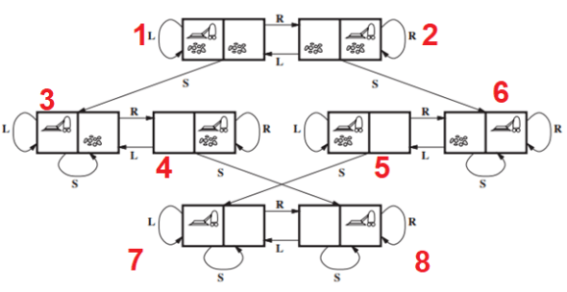

Slide 11
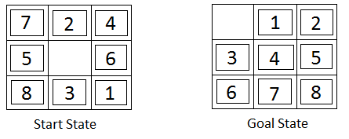
The 8-puzzle(Sliding tile)
The 8-puzzle, an instance of which is shown in Figure, consists of a 3×3 board with eight numbered tiles and a blank space.
A tile adjacent to the blank space can slide into the space. The object is to reach a specified goal state, such as the one shown on the right of the figure.
The standard formulation is as follows
States: A state description specifies the location of each of the eight tiles and the blank in one of the nine squares.
Initial state: Any state can be designated as the initial state. Note that any given goal can be reached from exactly half of the possible initial states .

Slide 12
Actions: The simplest formulation defines the actions as movements of the blank space Left, Right, Up, or Down. Different subsets of these are possible depending on where the blank is.
Transition model: Given a state and action, this returns the resulting state; for example, if we apply Left to the start state in Figure, the resulting state has the 5 and the blank switched.
Goal test: This checks whether the state matches the goal configuration shown in Figure. (Other goal configurations are possible.)
Path cost: Each step costs 1, so the path cost is the number of steps in the path.

Slide 13
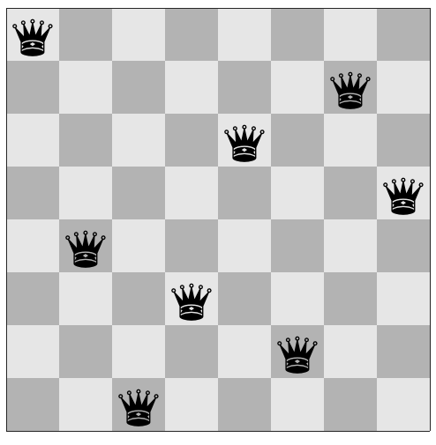
8-queens problem
The goal of the 8-queens problem is to place eight queens on a chessboard such that no queen attacks any other. (A queen attacks any piece in the same row, column or diagonal)
The first incremental formulation one might try is the following:
States: Any arrangement of 0 to 8 queens on the board
is a state.
Initial state: No queens on the board.
Actions: Add a queen to any empty square.
Transition model: Returns the board with a queen
added to the specified square.
Goal test: 8 queens are on the board, none attacked.

Slide 14
Real-world problems
Route-finding algorithms are used in a variety of applications.
Such as routing video streams in computer networks, military operations planning, and airline travel-planning systems, involve much more complex specifications. Consider the airline travel problems that must be solved by a travel-planning Web site.
States: Each state obviously includes a location (e.g., an airport) and the current time. Furthermore, because the cost of an action (a flight segment) may depend on previous segments, their fare bases, and their status as domestic or international, the state must record extra information about these “historical” aspects.
Initial state: This is specified by the user’s query.
Actions: Take any flight from the current location, in any seat class, leaving after the current time, leaving enough time for within-airport transfer if needed.
Transition model: The state resulting from taking a flight will have the flight’s destination as the current location and the flight’s arrival time as the current time.
Goal test: Are we at the final destination specified by the user?
Path cost: This depends on monetary cost, waiting time, flight time, customs and immigration procedures, seat quality, time of day, type of airplane, frequent-flyer mileage awards, and so on

Slide 15
The traveling salesperson problem (TSP) is a touring problem in which each city must be visited exactly once. The aim is to find the shortest tour.
The problem is known to be NP-hard, but an enormous amount of effort has been expended to improve the capabilities of TSP algorithms.
In addition to planning trips for traveling salespersons, these algorithms have been used for tasks such as planning movements of automatic circuit-board drills and of stocking machines on shop floors.

Slide 16
A VLSI layout problem
Requires positioning millions of components and connections on a chip to minimize area, minimize circuit delays, minimize stray capacitances, and maximize manufacturing yield.
The layout problem comes after the logical design phase and is usually split into two parts:
i)cell layout ii)channel routing.
In cell layout, the primitive components of the circuit are grouped into cells, each of which performs some recognized function.
Each cell has a fixed footprint (size and shape) and requires a certain number of connections to each of the other cells.
The aim is to place the cells on the chip so that they do not overlap and so that there is room for the connecting wires to be placed between the cells.
Channel routing finds a specific route for each wire through the gaps between the cells. These search problems are extremely complex, but definitely worth solving.

Slide 17
Robot navigation
It is a generalization of the route-finding problem described earlier.
Rather than following a discrete set of routes, a robot can move in a continuous space with (in principle) an infinite set of possible actions and states.
For a circular robot moving on a flat surface, the space is essentially two-dimensional.
When the robot has arms and legs or wheels that must also be controlled, the search space becomes many-dimensional.
Advanced techniques are required just to make the search space finite.

Slide 18
1.11 Searching for Solutions
A solution is an action sequence, so search algorithms work by considering various possible action sequences.
The possible action sequences starting at the initial state form a search tree with the initial state at the root; the branches are actions and the nodes correspond to states in the state space of the problem.
The root node of the tree corresponds to the initial state, In(Arad).
The first step is to test whether this is a goal state. (Clearly it is not, but it is important to check so that we can solve trick problems like “starting in Arad, get to Arad.”) Then we need to consider taking various actions.
We do this by expanding the current state; that is, applying each legal action to the current state, thereby generating a new set of states.
In this case, we add three branches from the parent node In(Arad) leading to three new child nodes: In(Sibiu), In(Timisoara), and In(Zerind). Now we must choose which of these three possibilities to consider further.

Slide 19
Loopy paths are a special case of the more general concept of redundant paths, which exist whenever there is more than one way to get from one state to another.
Consider the paths Arad–Sibiu (140 km long) and Arad–Zerind–Oradea–Sibiu (297 km long). Obviously, the second path is redundant—it’s just a worse way to get to the same state.
If you are concerned about reaching the goal, there’s never any reason to keep more than one path to any given state, because any goal state that is reachable by extending one path is also reachable by extending the other.

Slide 20
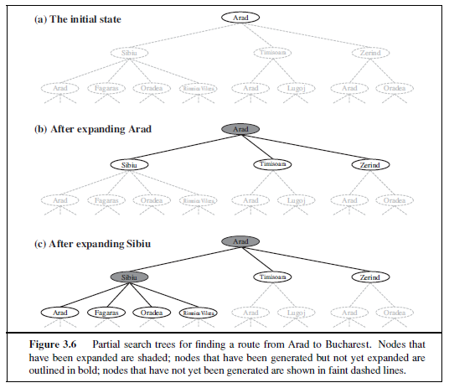

Slide 21
The way to avoid exploring redundant paths is to remember where one has been. To do this, we augment the TREE-SEARCH algorithm with a data structure called the explored set (also CLOSED LIST known as the closed list), which remembers every expanded node.
Newly generated nodes that match previously generated nodes—ones in the explored set can be discarded instead of being added to the frontier.
The new algorithm, called GRAPH-SEARCH, is shown informally in Figure.

Slide 22
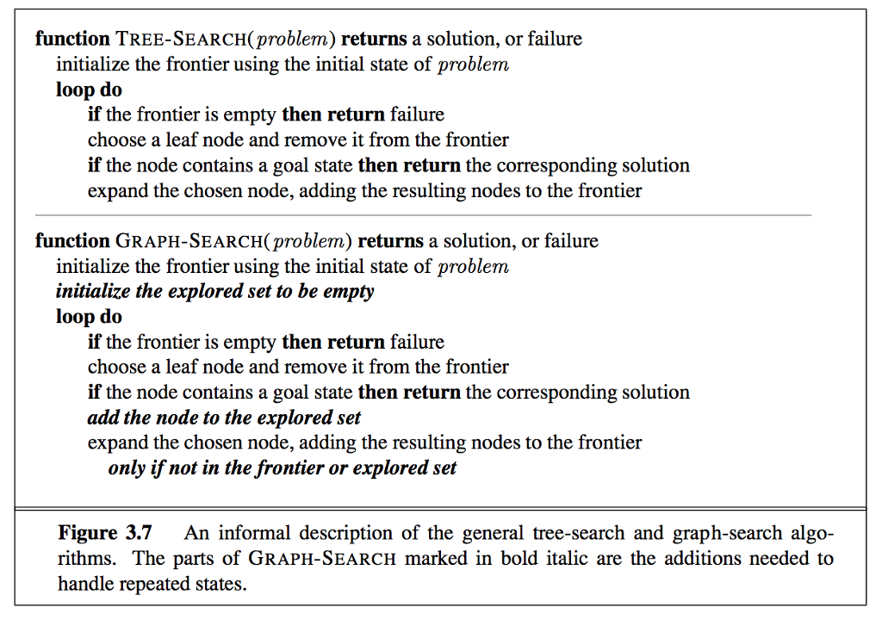

Slide 23
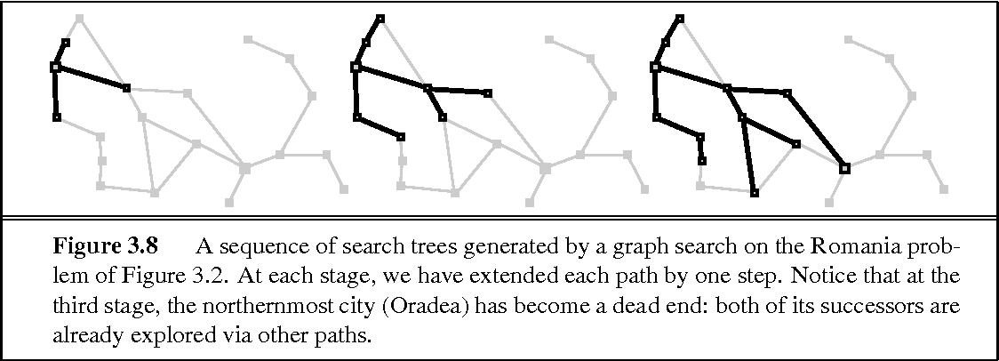
Clearly, the search tree constructed by the GRAPH-SEARCH algorithm contains at most one copy of each state, so we can think of it as growing a tree directly on the state-space graph, as shown in Figure .
The algorithm has another nice property: the frontier separates the state-space graph into the explored region and the unexplored region, so that every path from the initial state to an unexplored state has to pass through a state in the frontier.

Slide 24
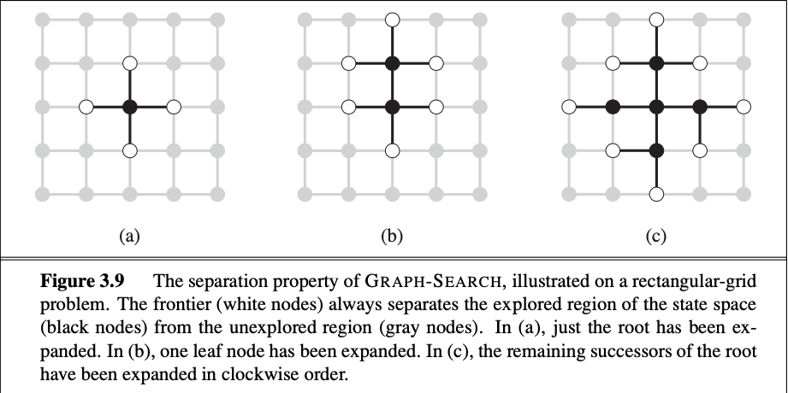
As every step moves a state from the frontier into the explored region while moving some states from the unexplored region into the frontier, we see that the algorithm is systematically examining the states in the state space, one by one, until it finds a solution.

Slide 25
Best-First Search
Best-first search is based on expanding the best partial path from current node to goal node. Here forward motion is from the best open node so far in the partially developed tree.
Best First Search is an informed search that uses an evaluation function to decide which adjacent is the most promising before it can continue to explore.
The cost of partial paths is calculated using some heuristic.
If the state has been generated earlier and new path is better than the previous one, then change the parent and update the cost.
It is not guaranteed to find an optimal solution, but generally it finds some solution faster than solution obtained from any other method.
The performance varies directly with the accuracy of the heuristic evaluation function.

Slide 26
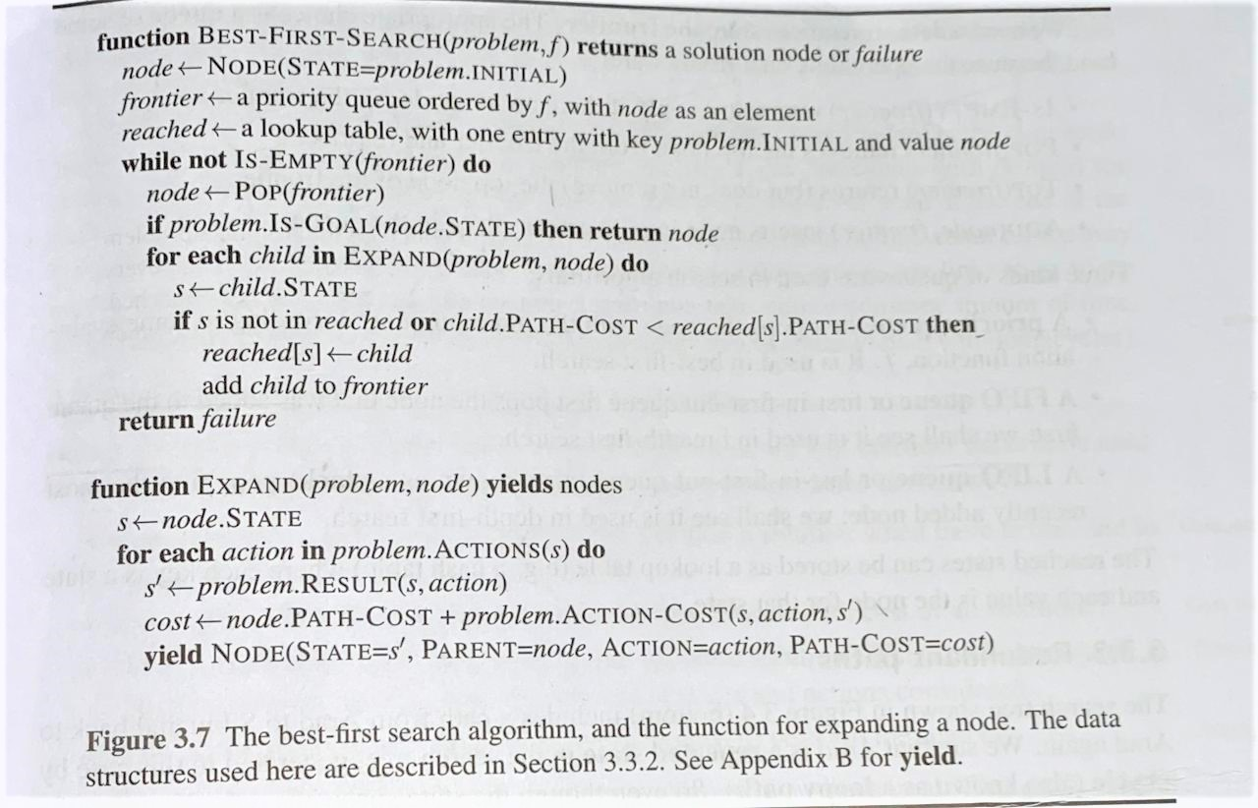

Slide 27
Infrastructure for search algorithms
Search algorithms require a data structure to keep track of the search tree that is being constructed.
For each node n of the tree, we have a structure that contains four components:
n.STATE: the state in the state space to which the node corresponds;
n.PARENT: the node in the search tree that generated this node;
n.ACTION: the action that was applied to the parent to generate the node;
n.PATH-COST: the cost, traditionally denoted by g(n), of the path from the initial state to the node, as indicated by the parent pointers
Given the components for a parent node, it is easy to see how to compute the necessary components for a child node.

Slide 28
The function CHILD-NODE takes a parent node and an action and returns the resulting child node:
function CHILD-NODE(problem, parent, action) returns a node
return a node with
STATE = problem. RESULT(parent . STATE, action),
PARENT = parent,
ACTION = action,
PATH-COST = parent. PATH-COST + problem. STEP-COST(parent . STATE, action)
Now that we have nodes, we need somewhere to put them.
The frontier needs to be stored in such a way that the search algorithm can easily choose the next node to expand according to its preferred strategy.
The appropriate data structure for this is a queue. The operations on a queue are as follows:
EMPTY?(queue) returns true only if there are no more elements in the queue.
POP(queue) removes the first element of the queue and returns it.
INSERT(element, queue) inserts an element and returns the resulting queue

Slide 29
Measuring problem-solving performance
Following are the four essential properties of search algorithms to compare the efficiency of these algorithms:
Completeness: A search algorithm is said to be complete if it guarantees to return a solution if at least any solution exists for any random input.
Optimality: If a solution found for an algorithm is guaranteed to be the best solution (lowest path cost) among all other solutions, then such a solution for is said to be an optimal solution.
Time Complexity: Time complexity is a measure of time for an algorithm to complete its task.
Space Complexity: It is the maximum storage space required at any point during the search, as the complexity of the problem.

Slide 30
1.12 Uninformed Search Algorithms
Uninformed search algorithms do not have any domain knowledge. It works in a brute force manner and hence also called brute force algorithms.
It has no knowledge about how far the goal node is, it only knows how to traverse and distinguish between a leaf node and goal node.
It examines every node without any prior knowledge hence also called blind search algorithms.
Following are the various types of uninformed search algorithms:
Breadth-first Search
Depth-first Search
Depth-limited Search
Iterative deepening depth-first search
Uniform cost search
Bidirectional Search

Slide 31
Breadth-first search
Breadth-first search is a simple strategy in which the root node is expanded first, then all the successors of the root node are expanded next, then their successors, and so on.
In general, all the nodes are expanded at a given depth in the search tree before any nodes at the next level are expanded
Breadth-first search is an instance which uses a FIFO queue for the frontier.
Thus, new nodes (which are always deeper than their parents) go to the back of the queue, and old nodes, which are shallower than the new nodes, get expanded first.
There is one slight tweak on the general graph-search algorithm, which is that the goal test is applied to each node when it is generated rather than when it is selected for expansion.
It discards any new path to a state which is already in the frontier or explored set.

Slide 32
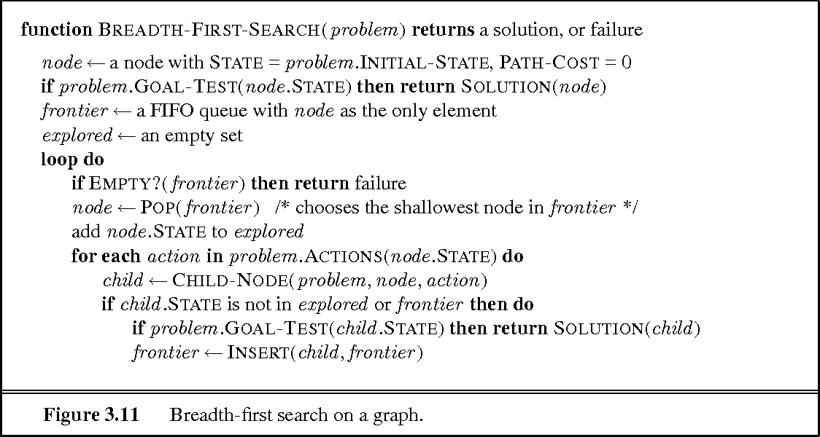
Breadth-first search on a graph

Slide 33
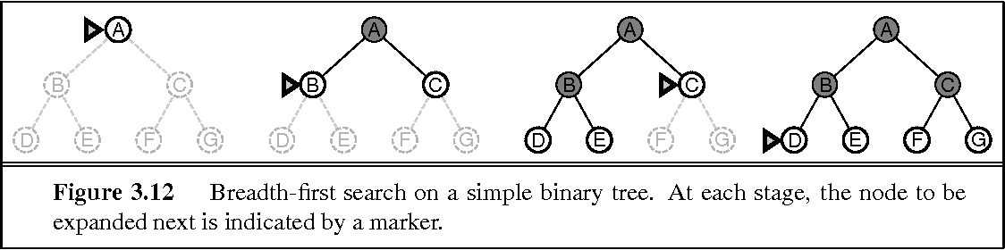
Figure shows the progress of the search on a simple binary tree
Advantages:
BFS will provide a solution if any solution exists.
If there are more than one solutions for a given problem, then BFS will provide the minimal solution which requires the least number of steps.
Disadvantages:
It requires lots of memory since each level of the tree must be saved into memory to expand the next level.
BFS needs lots of time if the solution is far away from the root node.

Slide 34
Time Complexity: Time Complexity of BFS algorithm can be obtained by the number of nodes traversed in BFS until the shallowest Node. Where the d= depth of a node(solution) and b is a branching factor.
T (b) = O (b^{d})
Space Complexity: Space complexity of BFS algorithm is given by the Memory size of frontier which is O(b^{d}).
Completeness: BFS is complete, which means if the shallowest goal node is at some finite depth, then BFS will find a solution.
Optimality: BFS is optimal if path cost is a non-decreasing function of the depth of the node.

Slide 35
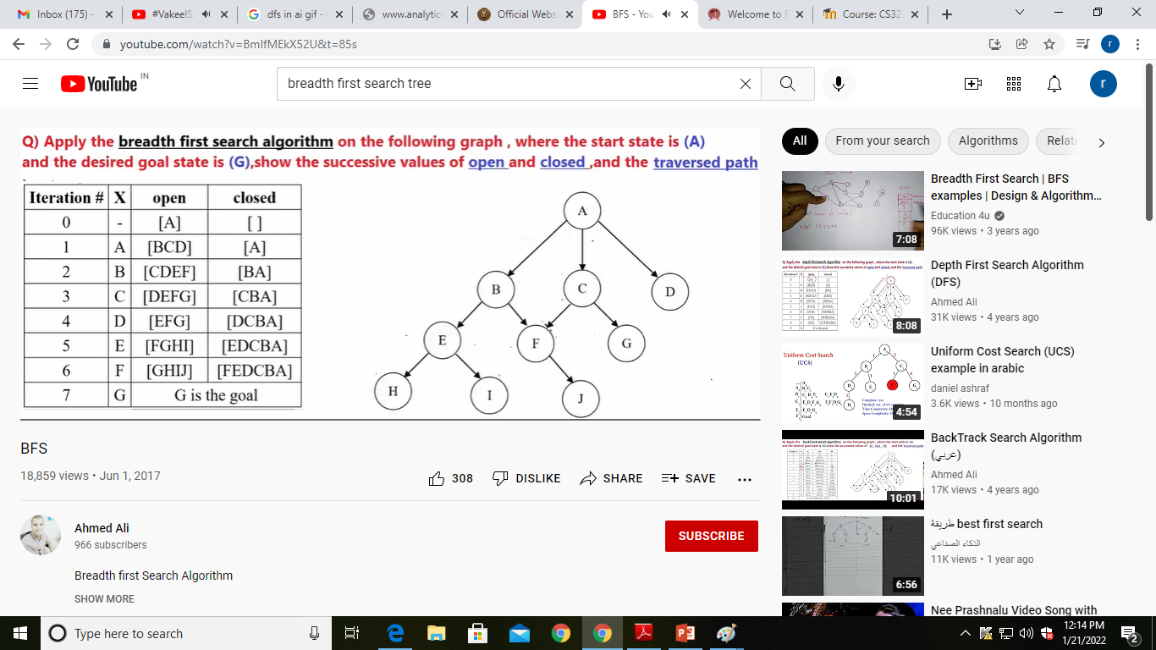

Slide 36
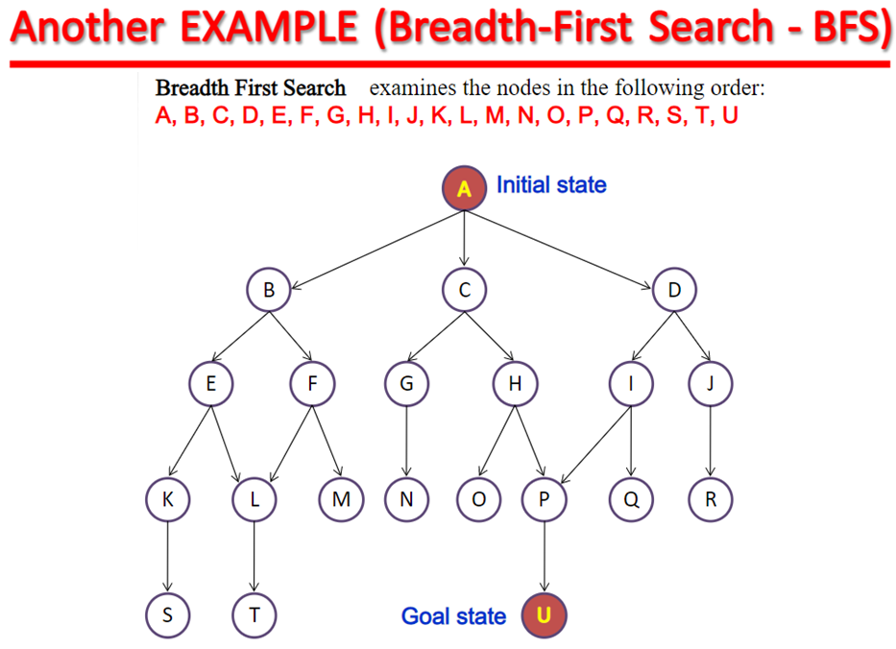

Slide 37
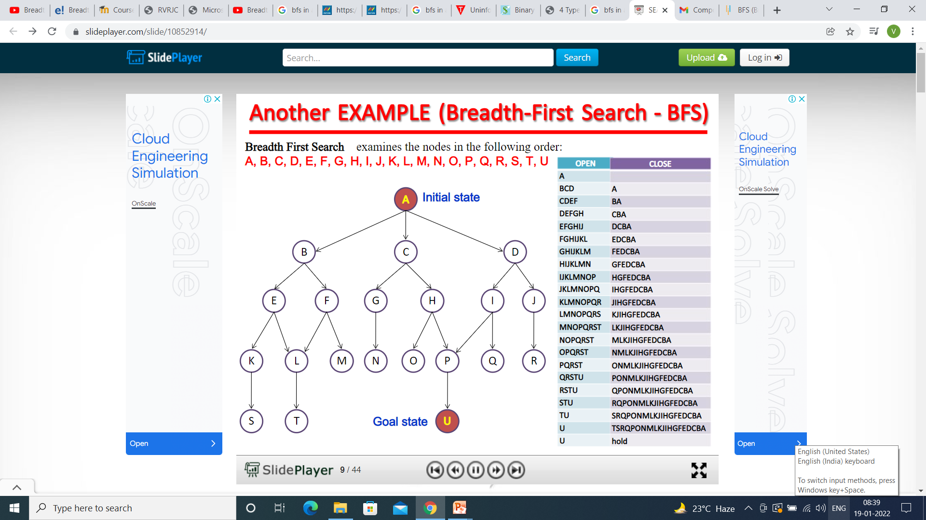

Slide 38
Application-1 Water jug problem
There is a 4l container and 3l container ; neither has any measuring markers on it. There is a pump that can be used to fill the containers with water .
Problem to solve is to get exactly two liters of water in the 4l container by using BFS
SOLUTION : From initial state to goal state through appropriate sequence of moves or actions such as filling and emptying the containers.
Content of the two containers at any given time is a problem state
Let x - content of the 4l container y - content of the 3l container
Then (x,y) - problem state represented by an ordered pair. The set of all ordered pairs is the space of problem states or the state-space of the problem . State-space : { (x,y) | x = 0,1,2,3,4 y=0,1,2,3 }

Slide 39
Rule NO | Operators for the problem state-space | The forwarded set of production rules
1. | Fill the 4l container | IF (x,y| x?4) THEN (4,y)
2 | Fill the 3l container | IF (x,y| y?3) THEN (x,3)
3 | Empty the 4l container | IF (x,y| x>0) THEN (0,y)
4 | Empty the 3l container | IF (x,y| y>0) THEN (x,0)
5 | Pour water from 3l container into 4l container until 4l container is full | IF (x,y| x+y>=4 ? y>0 ? x?4) THEN (4,y-(4-x))
6 | Pour water from 4l container into the 3l container until the 3l container is full | IF (x,y| x+y>=3 ? x>0 ? y?3) THEN (x-(3-y),3)
7 | Pour all the water from 3l container into the 4l container | IF (x,y| x+y?=4 ? y>0) THEN (x+y,0)
8 | Pour all the water from 4l container into the 3l container | IF (x,y| x+y?=3 ? x>0) THEN (0,x+y)

Slide 40
Nodes are examined level by level. Open nodes are ordered in ascending order of their depth (nodes at the lowest level of the depth are at the front of the queue) FIFO structure.

Slide 41
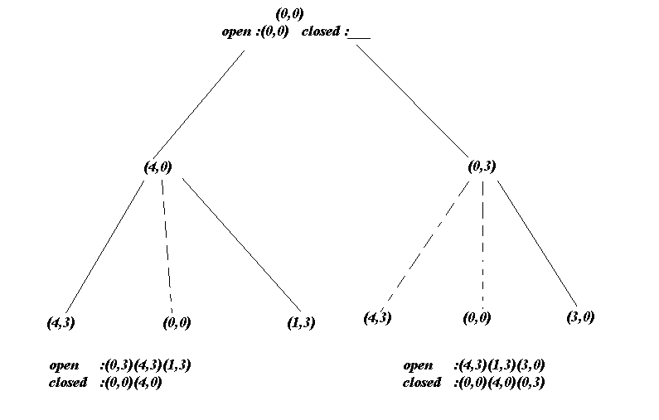

Slide 42
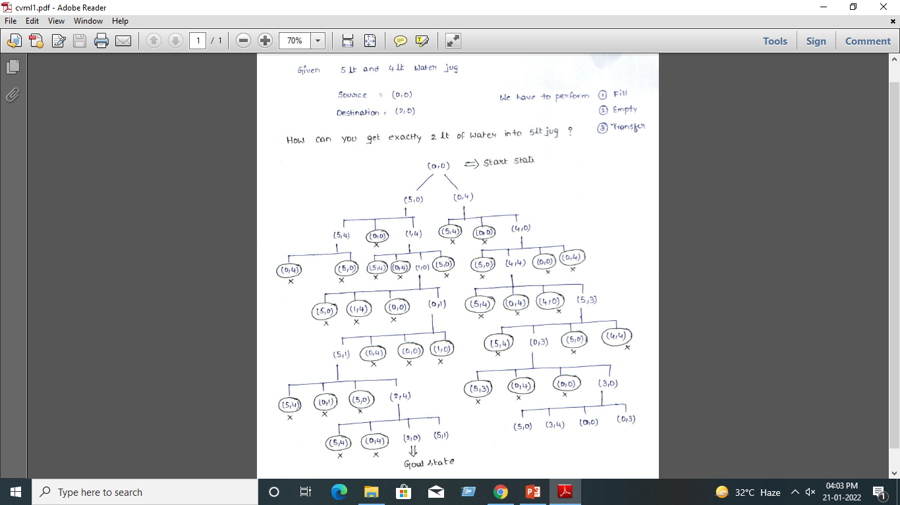

Slide 43
Uniform-cost search
Unlike BFS, this uninformed search explores nodes based on their path cost from the root node.
It expands a node n having the lowest path cost g(n), where g(n) is the total cost from a root node to node n.
Uniform-cost search is significantly different from the breadth-first search because of the following two reasons:
First, the goal test is applied to a node only when it is selected for expansion not when it is first generated because the first goal node which is generated may be on a suboptimal path.
Secondly, a goal test is added to a node, only when a better/ optimal path is found.
Thus, uniform-cost search expands nodes in a sequence of their optimal path cost because before exploring any node, it searches the optimal path.
Also, the step cost is positive so, paths never get shorter when a new node is added in the search.

Slide 44
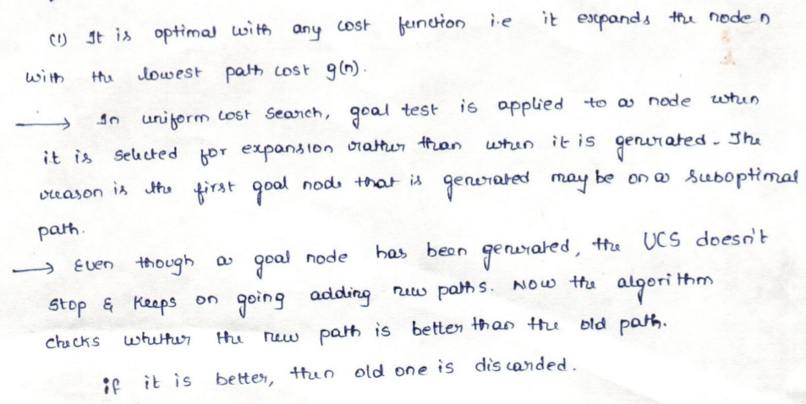

Slide 45
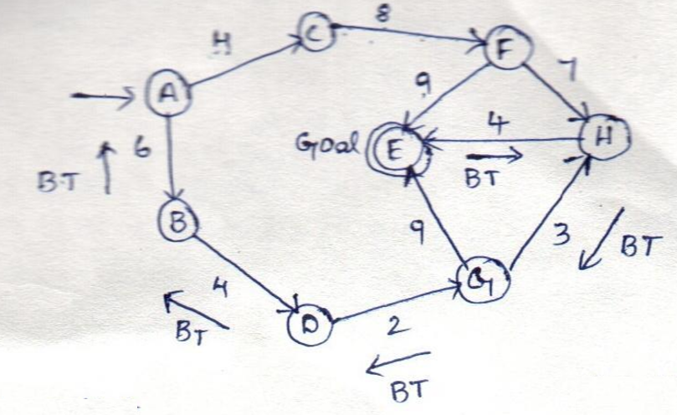

Slide 46
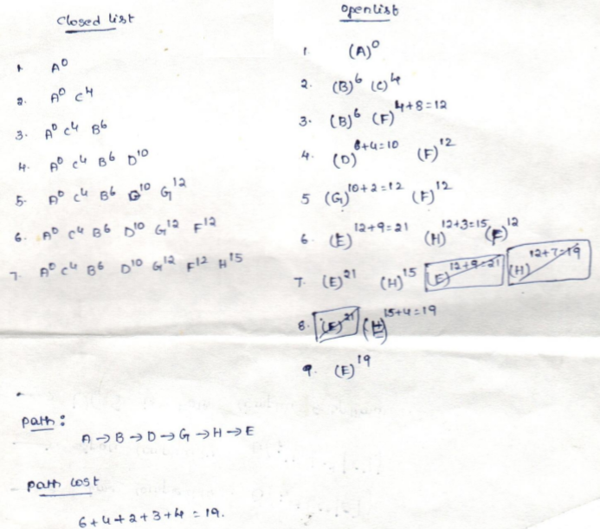

Slide 47
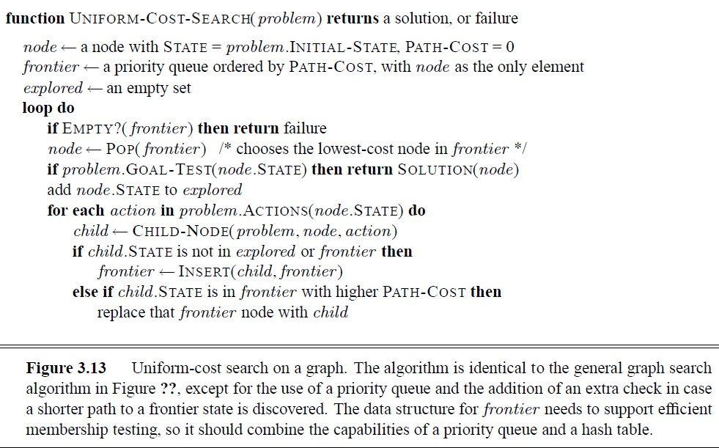

Slide 48
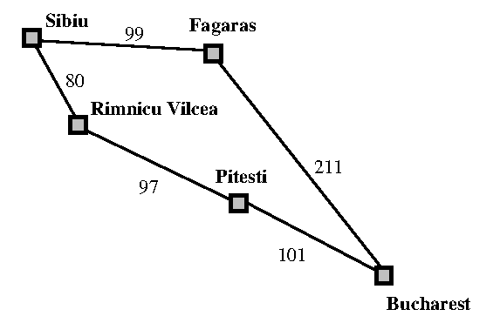
Where the problem is to get from Sibiu to Bucharest. The successors of Sibiu are Rimnicu Vilcea and Fagaras, with costs 80 and 99, respectively.
The least-cost node, Rimnicu Vilcea, is expanded next,
adding Pitesti with cost 80 + 97 = 177.
The least-cost node is now Fagaras, so it is expanded,
adding Bucharest with cost 99 + 211 = 310.
Now a goal node has been generated, but uniform-cost
search keeps going, choosing Pitesti for expansion and
adding a second path to Bucharest with cost 80+ 97+ 101 = 278.
Now the algorithm checks to see if this new path is better than the old one; it is, so the old one is discarded. Bucharest, now with g-cost 278, is selected for expansion and the solution is returned.

Slide 49
Depth-first search
Depth-first search always expands the deepest node in the current frontier of the search tree.
The search proceeds immediately to the deepest level of the search tree, where the nodes have no successors.
As those nodes are expanded, they are dropped from the frontier, so then the search “backs up” to the next deepest node that still has unexplored successors.
The breadth-first-search uses a FIFO queue, depth-first search uses a LIFO queue.
A LIFO queue means that the most recently generated node is chosen for expansion.
This must be the deepest unexpanded node because it is one deeper than its parent—which, in turn, was the deepest unexpanded node when it was selected.
The properties of depth-first search depend strongly on whether the graph-search or tree-search version is used.
The graph-search version, which avoids repeated states and redundant paths, is complete in finite state spaces because it will eventually expand every node.

Slide 50
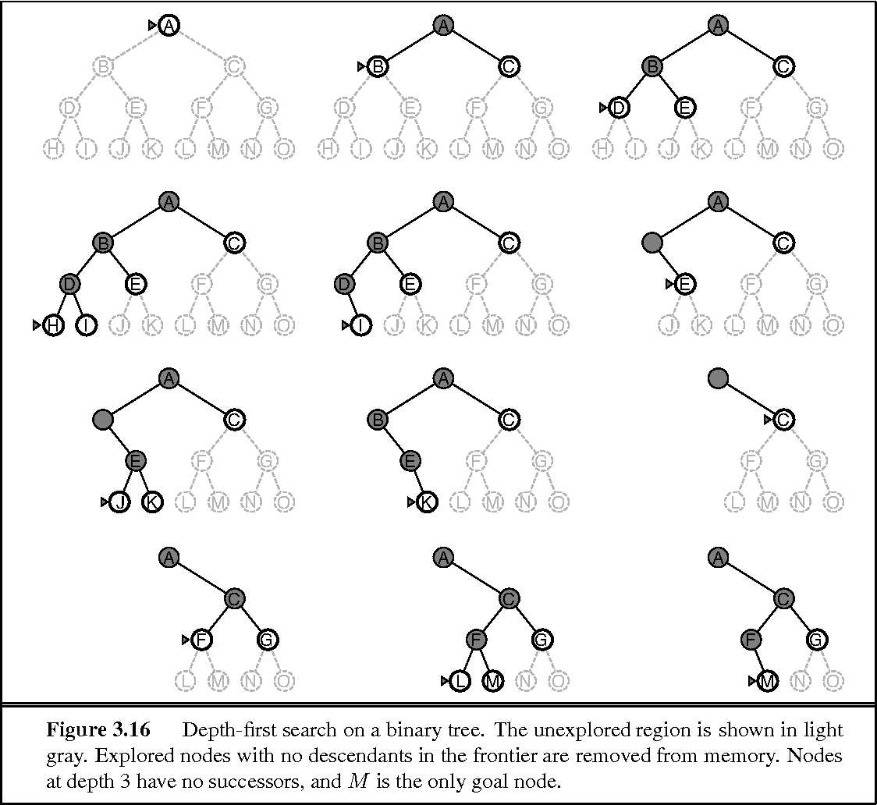

Slide 51
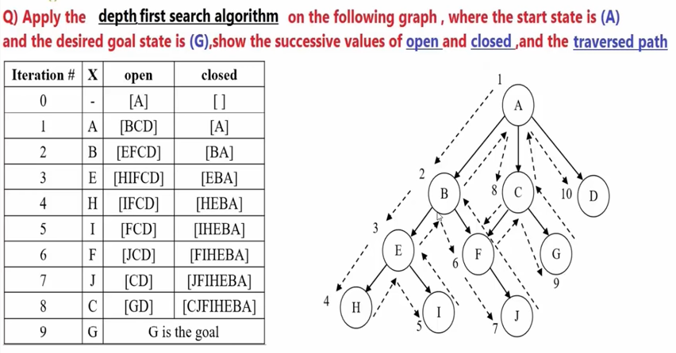

Slide 52
Application-1 Water jug
WATER JUG PROBLEM :
There is a 4l container and 3l container ; neither has any measuring markers on it. There is a pump that can be used to fill the containers with water .
Problem to solve is to get exactly 2 liters of water in the 4l container by using DFS
SOLUTION : From initial state to goal state through appropriate sequence of moves or actions such as filling and emptying the containers.
Content of the two containers at any given time is a problem state
Let x - content of the 4l container y - content of the 3l container
Then (x,y) - problem state represented by an ordered pair. The set of all ordered pairs is the space of problem states or the state-space of the problem . State-space : { (x,y) | x = 0,1,2,3,4 y=0,1,2,3 }

Slide 53
Rule NO | Operators for the problem state-space | The forwarded set of production rules
1. | Fill the 4l container | IF (x,y| x?4) THEN (4,y)
2 | Fill the 3l container | IF (x,y| y?3) THEN (x,3)
3 | Empty the 4l container | IF (x,y| x>0) THEN (0,y)
4 | Empty the 3l container | IF (x,y| y>0) THEN (x,0)
5 | Pour water from 3l container into 4l container until 4l container is full | IF (x,y| x+y>=4 ? y>0 ? x?4) THEN (4,y-(4-x))
6 | Pour water from 4l container into the 3l container until the 3l container is full | IF (x,y| x+y>=3 ? x>0 ? y?3) THEN (x-(3-y),3)
7 | Pour all the water from 3l container into the 4l container | IF (x,y| x+y?=4 ? y>0) THEN (x+y,0)
8 | Pour all the water from 4l container into the 3l container | IF (x,y| x+y?=3 ? x>0) THEN (0,x+y)

Slide 54
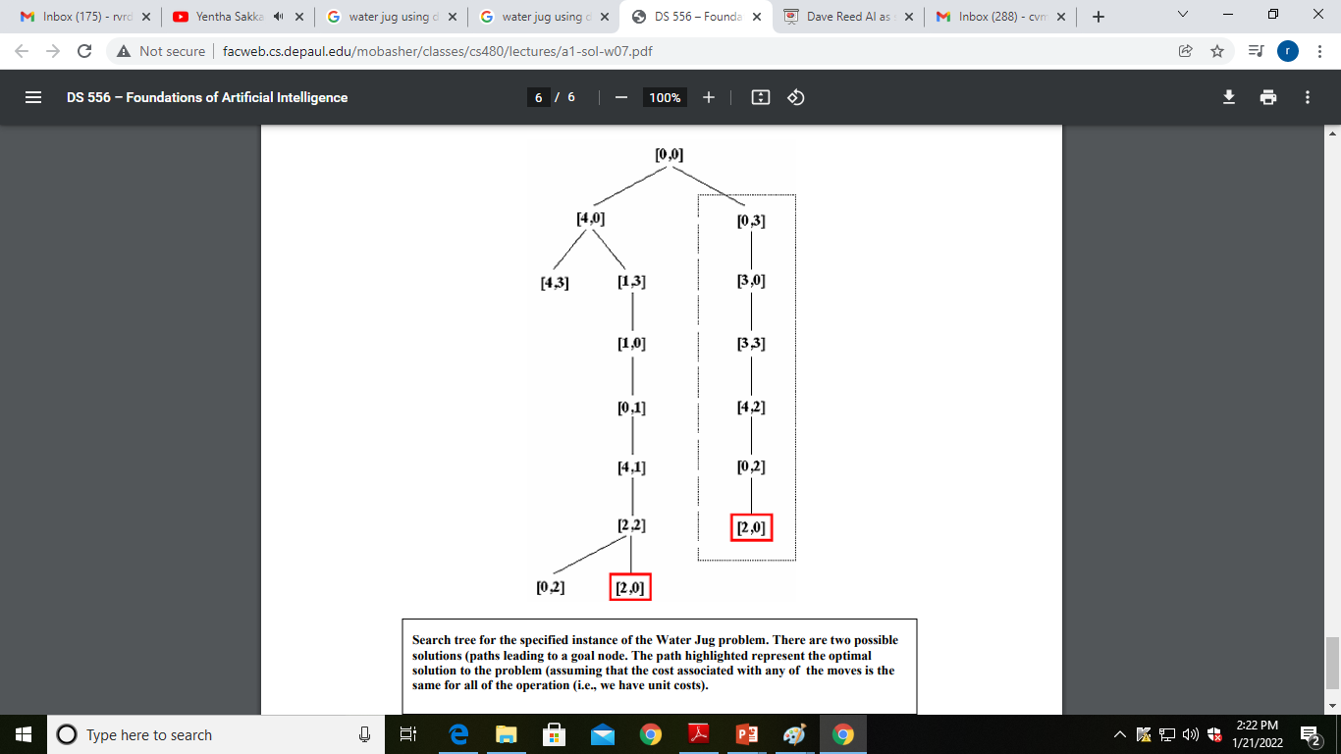
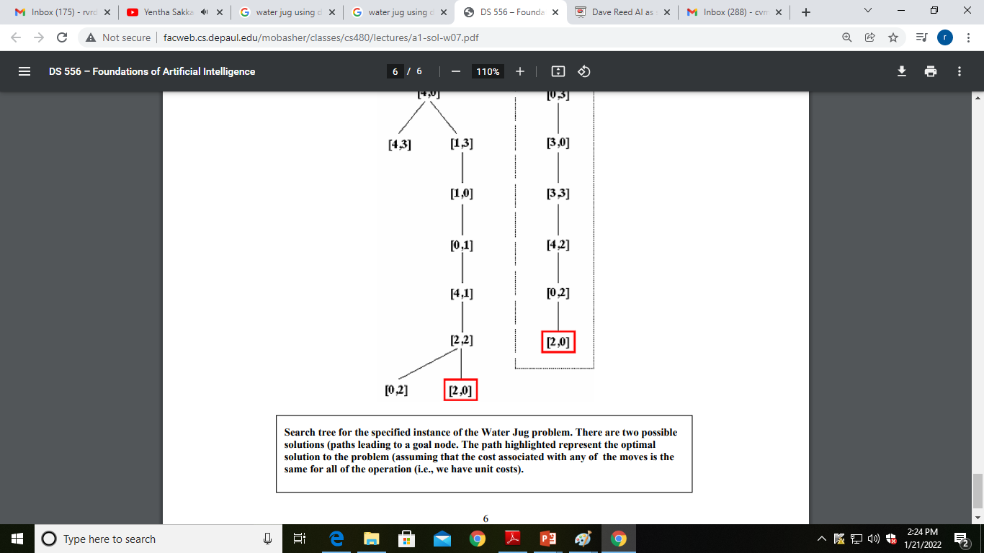

Slide 55
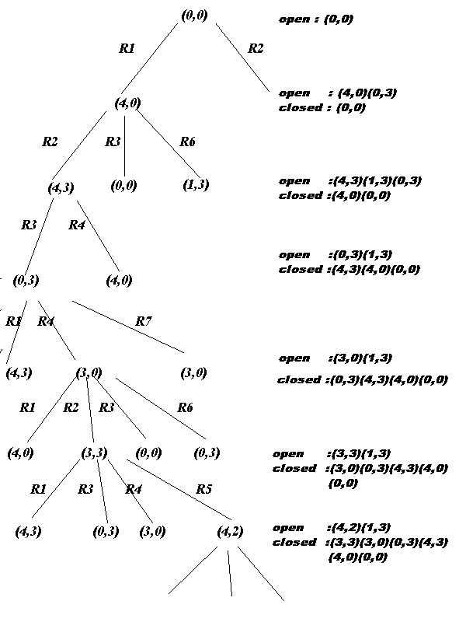
Notes:
http://ari.cankaya.edu.tr/~agorur/AI/AI/~ceng462/303/lect/chp3.html

Slide 56
There is a 5l container and 3l container ; neither has any measuring markers on it. There is a pump that can be used to fill the containers with water .
Problem to solve is to get exactly 4 liters of water in the 5l container by using BFS and DFS

Slide 57
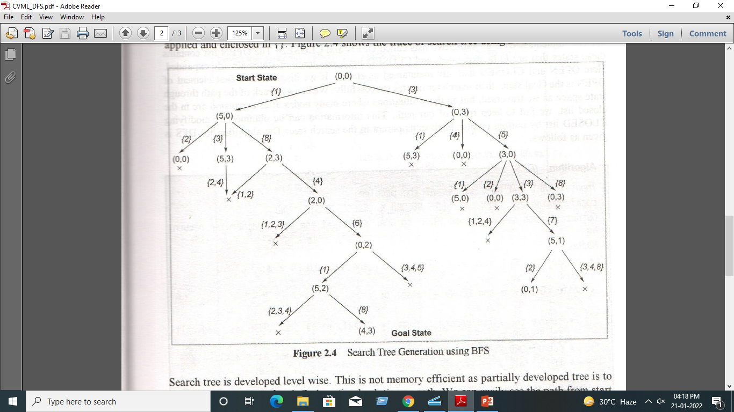

Slide 58
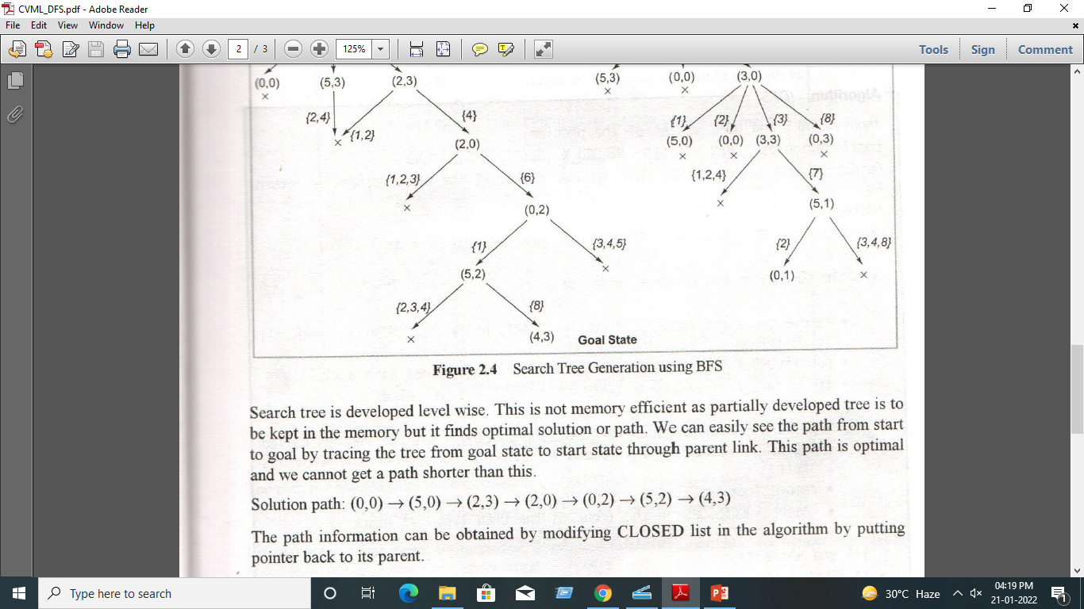

Slide 59
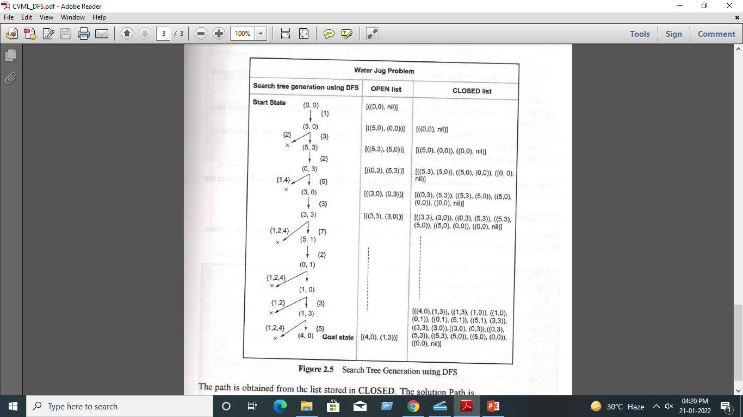

Slide 60
Advantage:
DFS requires very less memory as it only needs to store a stack of the nodes on the path from root node to the current node.
It takes less time to reach to the goal node than BFS algorithm (if it traverses in the right path).
Disadvantage:
There is the possibility that many states keep re-occurring, and there is no guarantee of finding the solution.
DFS algorithm goes for deep down searching and sometime it may go to the infinite loop.

Slide 61
Depth-limited search
This search strategy is similar to DFS with a little difference.
The difference is that in depth-limited search, we limit the search by imposing a depth limit l to the depth of the search tree.
It does not need to explore till infinity. As a result, the depth-first search is a special case of depth-limited search. when the limit l is infinite.
Depth-limited search can be halted in two cases:
SFV: The Standard Failure Value which tells that there is no solution to the problem.
CFV: The Cutoff Failure Value tells that there is no solution within the given depth.

Slide 62
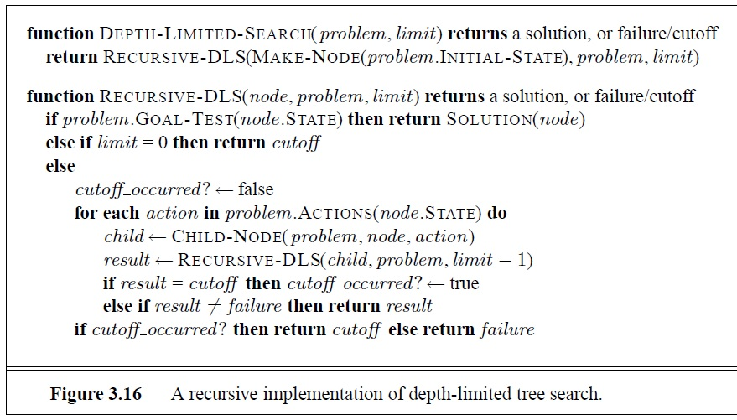

Slide 63
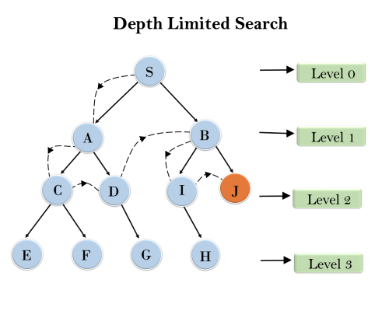
Advantages:
Depth-limited search is Memory efficient.
Disadvantages:
Depth-limited search also has a disadvantage of incompleteness.
It may not be optimal if the problem has more than one solution.

Slide 64
Iterative Deepening Depth-first Search
A combination of DFS and BFS algorithms, Iterative Deepening Depth-First Search identifies the best depth limit, by gradually increasing the limit until the goal is achieved.
Iterative deepening search (or iterative deepening depth-first search) is a general strategy, ITERATIVE DEEPENING SEARCH often used in combination with depth-first tree search, that finds the best depth limit.
It does this by gradually increasing the limit—first 0, then 1, then 2, and so on—until a goal is found.
This will occur when the depth limit reaches d, the depth of the shallowest goal node.
This searching strategy is extremely beneficial, as it combines the benefits of both Breadth-First Search and Depth-First Search.
The only drawback associated with this method is that it performs the search and work of previous stages.
The algorithm is shown in Figure. Iterative deepening combines the benefits of depth-first and breadth-first search.

Slide 65
Like breadth-first search, it is complete when the branching factor is finite and optimal when the path cost is a non decreasing function of the depth of the node.
Iterative deepening search may seem wasteful because states are generated multiple times.
It turns out this is not too costly. The reason is that in a search tree with the same (or nearly the same) branching factor at each level, most of the nodes are in the bottom level, so it does not matter much that the upper levels are generated multiple times.
In an iterative deepening search, the nodes on the bottom level (depth d) are generated once, those on the unlike the other two search algorithms, IDDFS is complete and is used to perform iterations of depth-limited searches while increasing the expected runtime.
Moreover, if a solution exists, IDDFS will find a solution path with the fewest arcs.

Slide 66
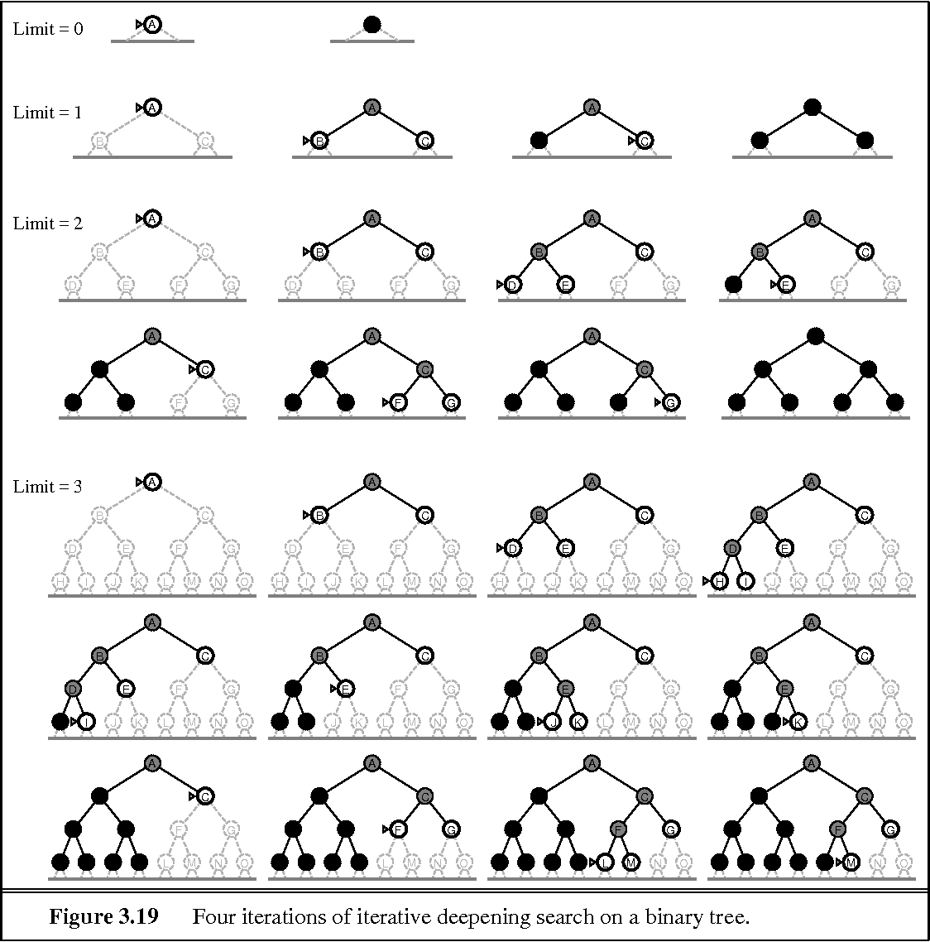

Slide 67
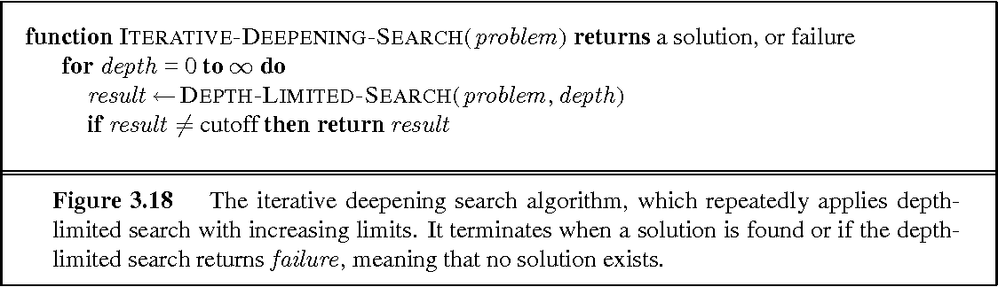
Advantages:
It combines the benefits of BFS and DFS search algorithm in terms of fast search and memory efficiency.
Disadvantages:
The main drawback of IDDFS is that it repeats all the work of the previous phase.

Slide 68
Bidirectional Search
The idea behind bidirectional search is to run two simultaneous searches—one forward from the initial state and the other backward from the goal—hoping that the two searches meet in the middle.
Bidirectional search is implemented by replacing the goal test with a check to see whether the frontiers of the two searches intersect; if they do, a solution has been found.
It is important to realize that the first such solution found may not be optimal, even if the two searches are both breadth-first; some additional search is required to make sure there isn’t another short-cut across the gap.
The check can be done when each node is generated or selected for expansion and, with a hash table, will take constant time.
Advantages: Disadvantages:
* Bidirectional search is fast. * Implementation of the bidirectional search tree is difficult.
* Bidirectional search requires less memory

Slide 69
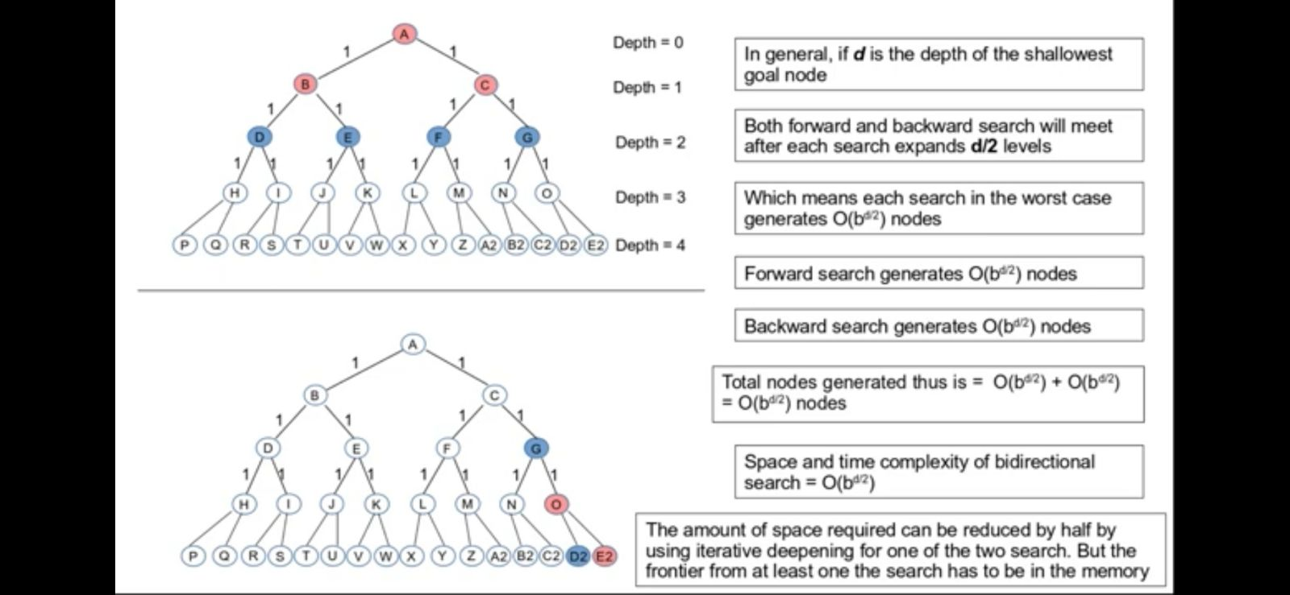
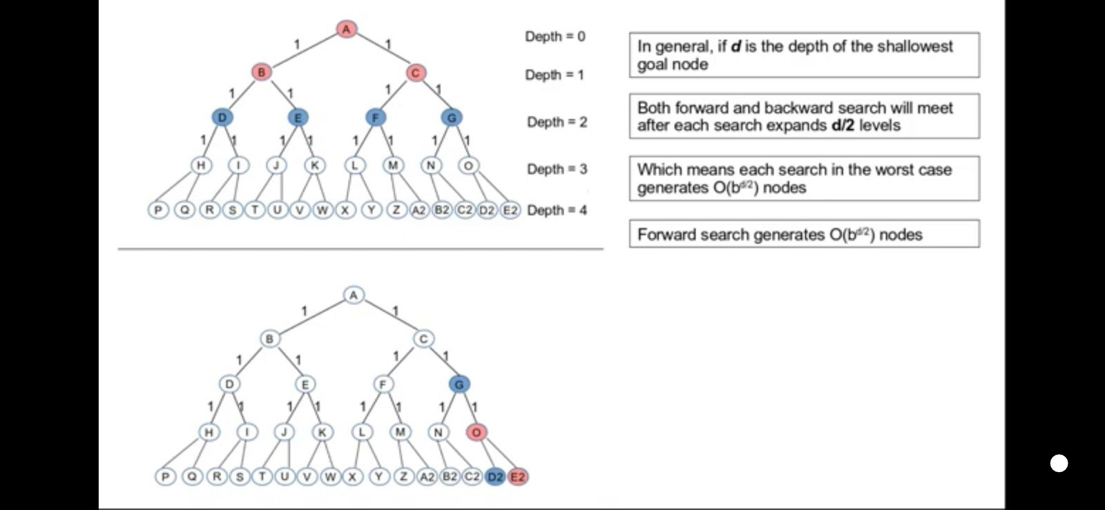
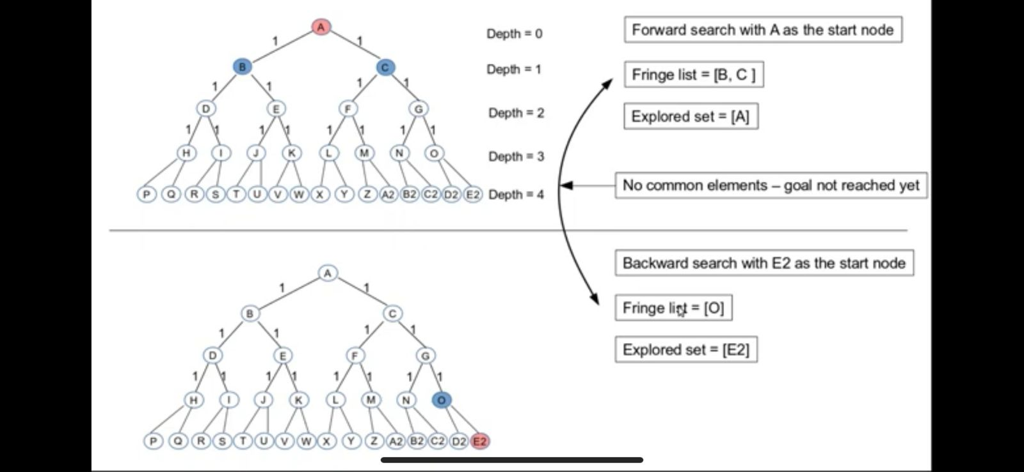
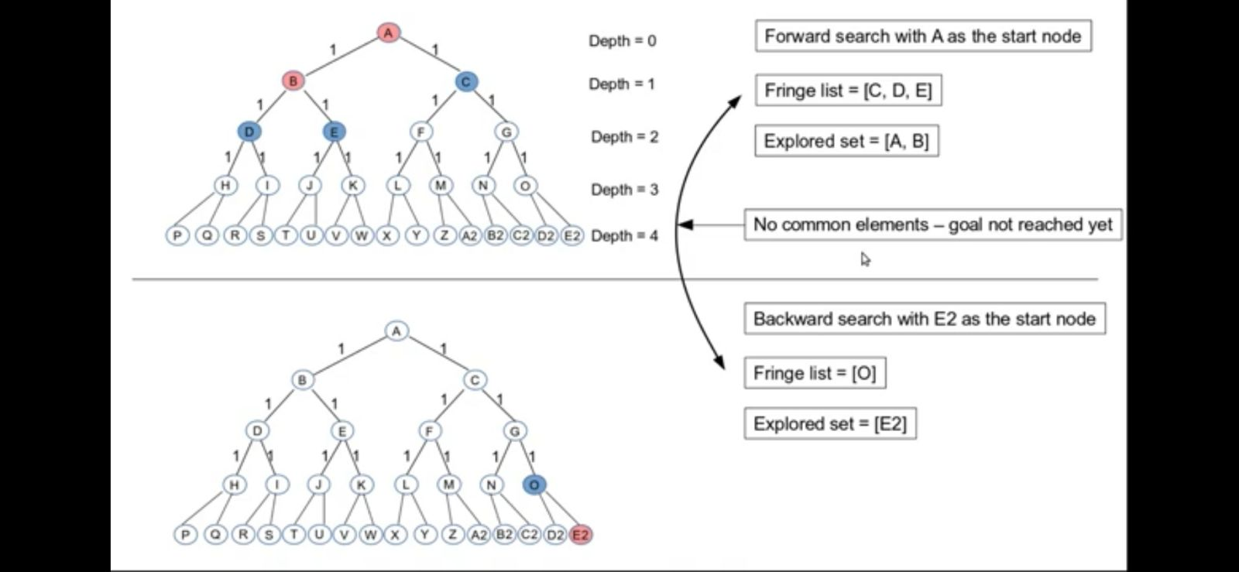
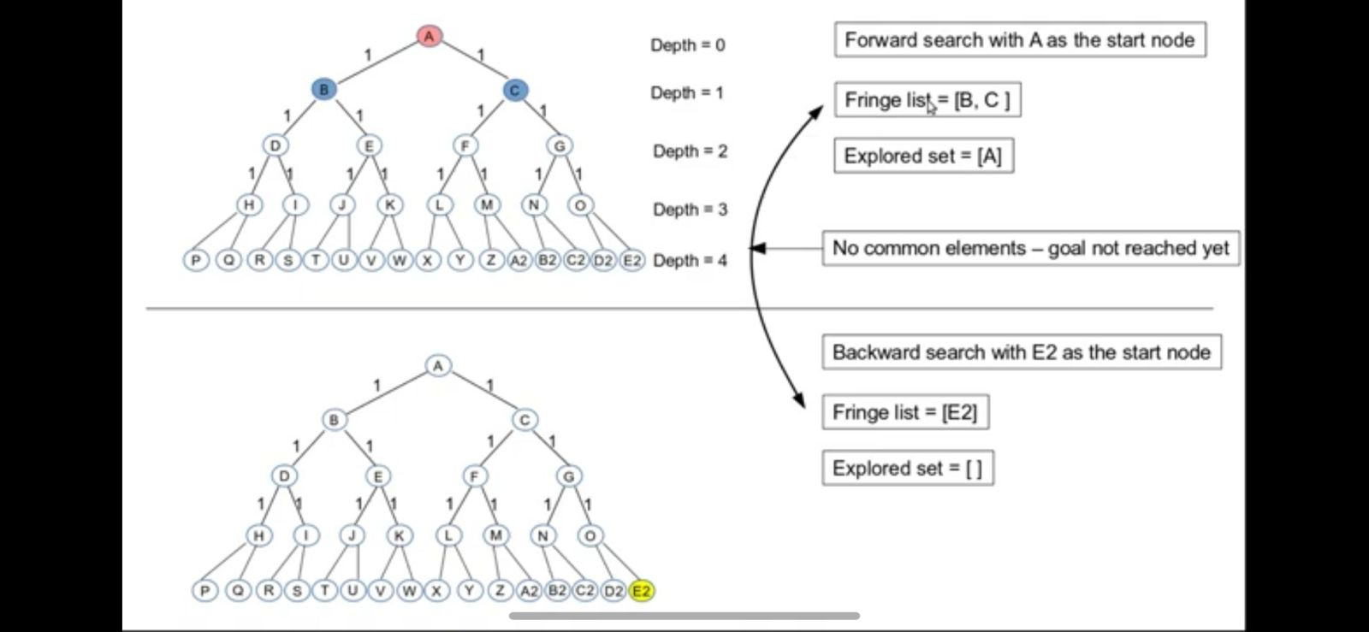
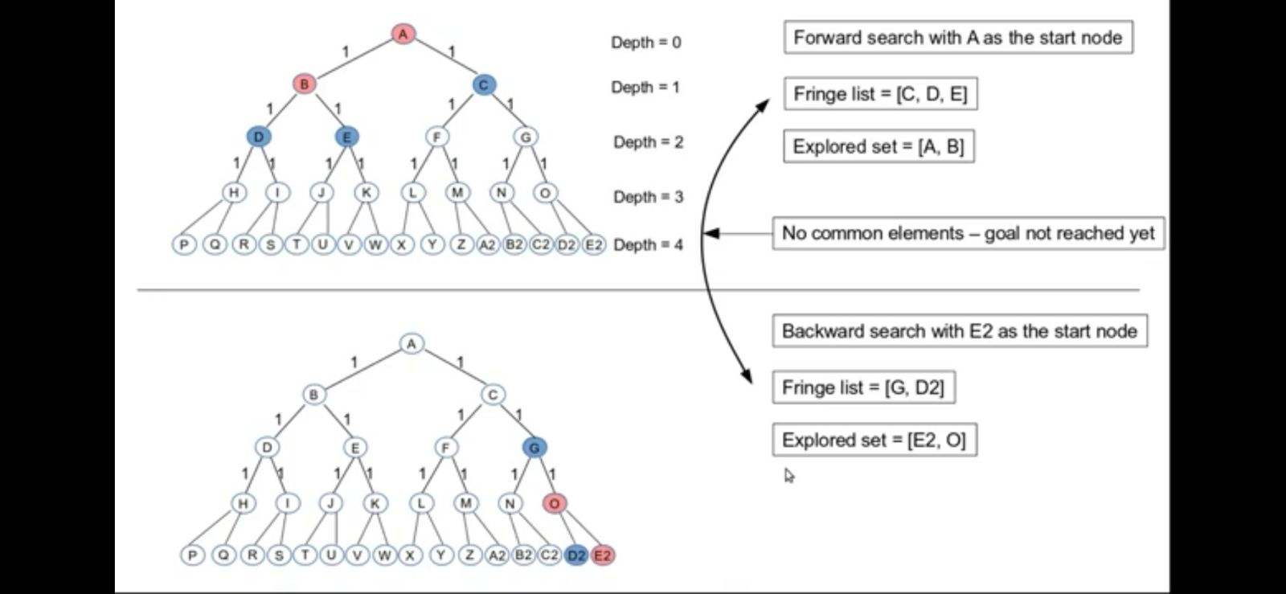
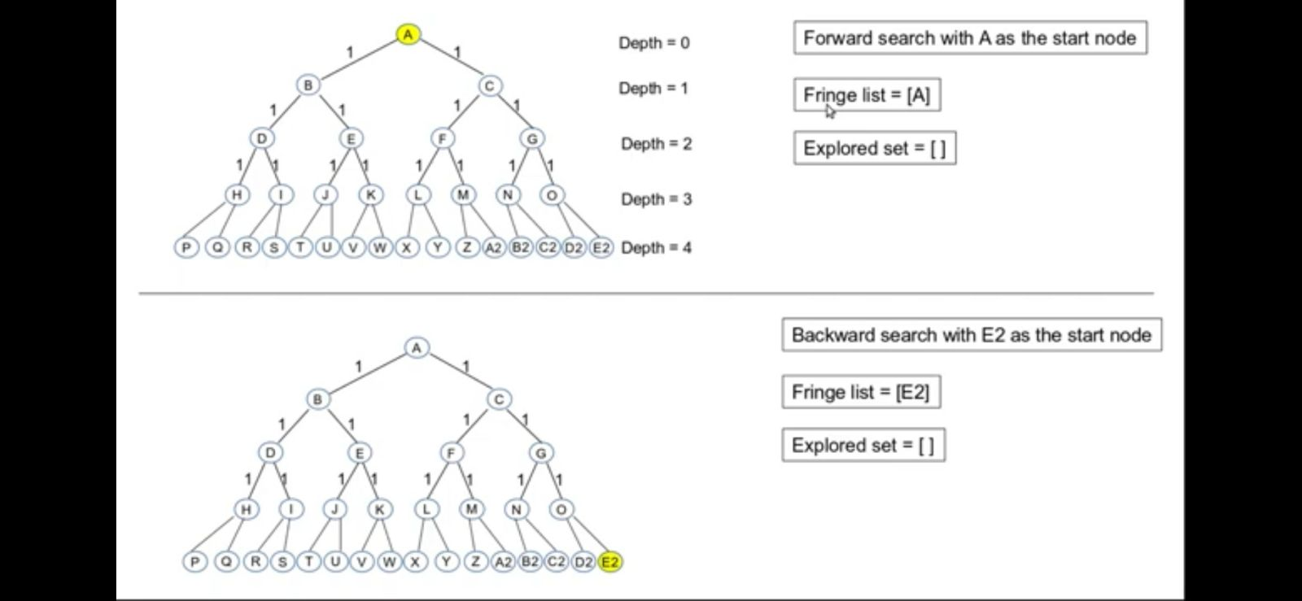
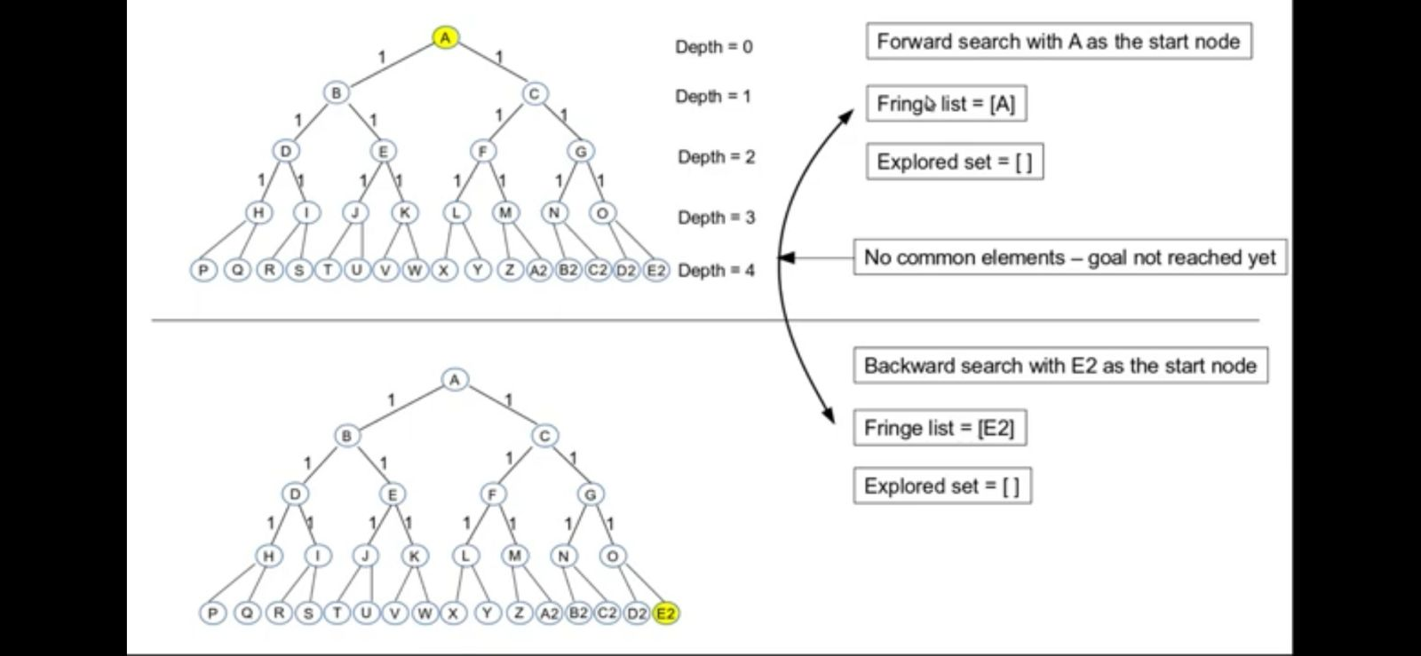
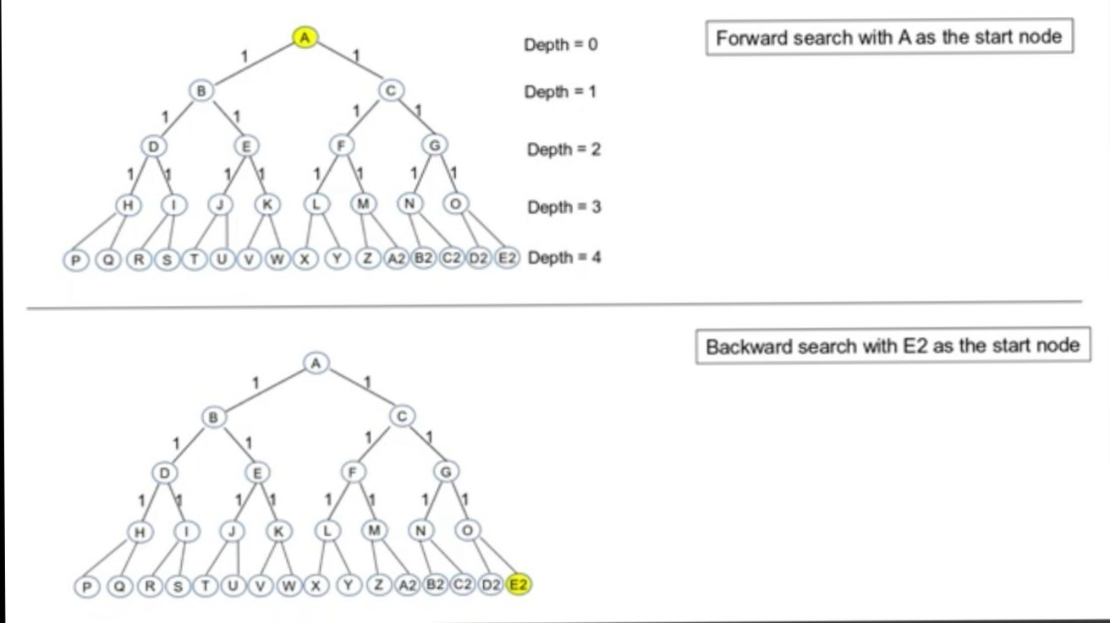
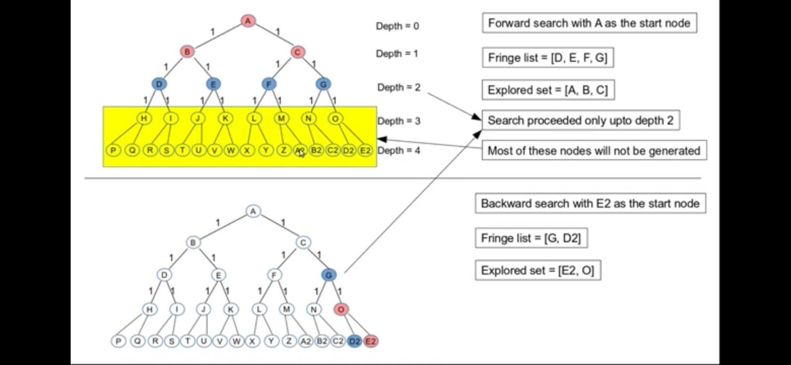
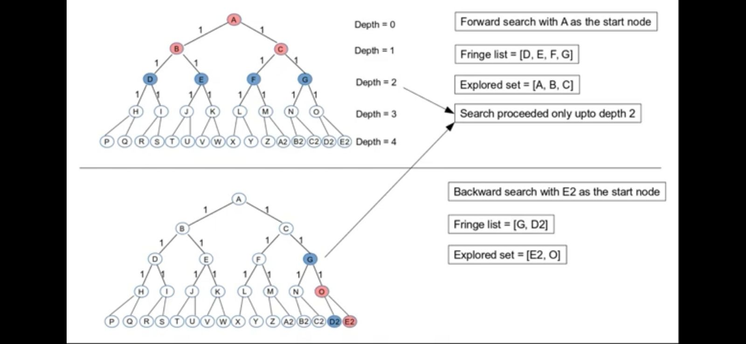

Slide 70
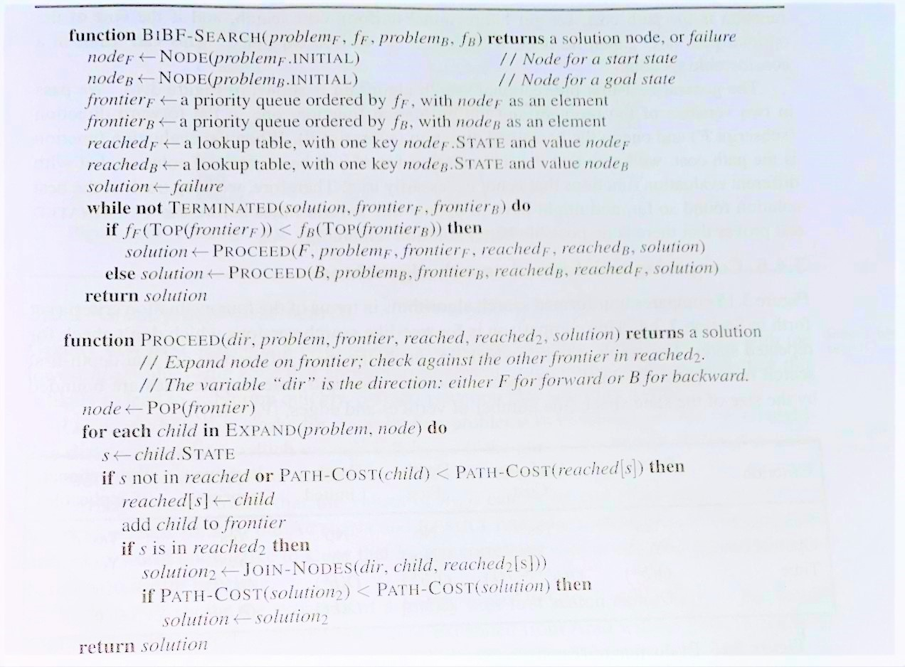
.

Slide 71
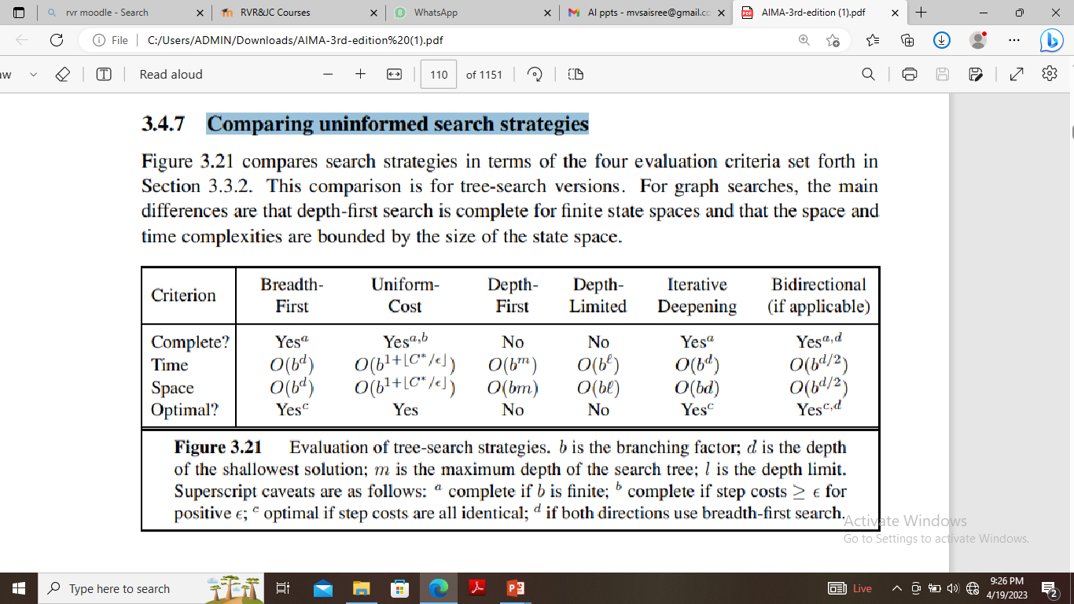
Comparing uninformed search strategies

